Slide 1
www.MINEPORTAL.in
ONLINE TEST SERIES FOR
DGMS COAL/METAL FIRST/SECOND CLASS EXAM
GATE MINING EXAM
OVERMAN EXAM TEST
MINING INSPECTOR EXAMS
COAL INDIA MTs & OTHER PSUs EXAMS
FREE STUDY MATERIAL & VIDEO LECTURES
MINING JOBS NOTIFICATIONS
www.mineportal.in Call/Whatsapp-8804777500 www.fb.com/mineportal.in

Slide 2

VENTSIM (Ventilation simulation)

Slide 3
INTRODUCTION
Ventsim is an underground mine ventilation simulation software package designed to model and simulate ventilation, airflows, pressures, heat, gases, financials, radon, fire, and many other types of ventilation data from a model of tunnels and shafts.
Ventsim was originally introduced to mining operations in 1994 to help visually design, improve and optimise underground ventilation systems. It is now licensed to over 1000 mine sites, consultants, universities, governments and research agencies around the world.
The new Ventsim Visual ventilation software was released in 2009 and offers a graphically rich and dynamic ventilation environment with many more features than the original Ventsim Classic. Ventsim Visual is available in three versions: Standard, Advanced and Premium.

Slide 4
Ventsim visual standard
Full 3D modelling, with smooth rotation, zoom and pan.
Real-time animation of airflow and fans.
Airflow simulation and fan modelling.
Basic contaminant spread, sourcing and emergency simulation.

Slide 5
Ventsim visual advanced
All the Standard features
Thermodynamic heat and moisture modelling
Strata heat and moisture
Compressible air flows and self adjusting fan curves
Blasting fumes dispersion and clearance times
Financial analysis wizards
Recirculation predictor
Electrical heat sources
Diesel heat and DPM emissions
Refrigeration

Slide 6
Ventsim visual premium
All Standard & Advanced features.
Radon simulation
VentLog ventilation survey record software.
LiveVIEW remote data connection and display module.
VentFIRE fire heat, gas and airflow direction simulation.

Slide 7
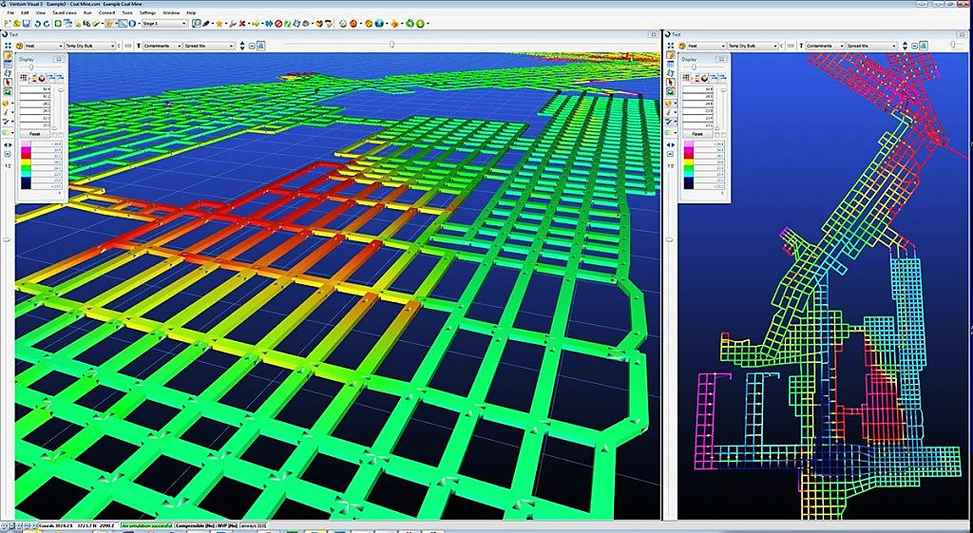
VENTILATION LAYOUT OF A COAL MINE PREPARED USING VENTSIM

Slide 8
Computer Hardware Requirements
Recommended Configuration
Intel based 32 or 64 bit dual core processor 2 Ghz +
Windows XP, Vista or Windows 7,Windows 8- 32 or 64 bit
Memory 4Gb of Ram. Hard Drive Space 100Mb +
Dedicated /Discrete Graphics card from INTEL, ATI or NVIDIA with greater than 128Mb or RAM. INTEL CORE ’i’ processors (generally sold from 2010 onwards) now have reasonable graphical power and perform well with VENTSIM without a dedicated graphics card.
Two button mouse with centre scroll / click wheel

Slide 9
Functionality
Ventsim considers every section between two points as a separate airway. To minimize the number of airways the simplification function will combine set lengths of airways to equivalent lengths. The vent calculations will produce the same results but with less clutter on screen.
The “binding” filter connects airways whose ends are close to touching. This allows a proper ventilation circuit to be created and identifies loose ends. The third filtering tool removes duplicate segments and points to eliminate the possibility of running calculations for the same heading twice.

Slide 10
.
A circuit in Ventsim must have an entry from surface and an exit, or multiples of either. A closed circuit is also possible but not practical for underground mining. The directions in headings can be set to match the planned direction of airflow. Ventsim also has automatic heading directions which are based on how air would naturally flow when fans are setup.
The airflow simulation can be setup a number of ways, by adding fans each with individual fan curves, setting a fixed flow in a heading or setting a fixed pressure in a heading. By using fan selection a realistic circuit can be created with the amount of airflow that would actually be created by that fan with the given mine resistance. Once an airflow simulation is completed the other packages can be used such as thermodynamic, contaminants, diesel particulates, recirculation and financials

Slide 11
The thermodynamic simulator is a powerful package that can incorporate the surface temperature, rock temperature varying with depth, equipment heat production and cooling units. The temperatures will be calculated for each airway section, giving a flow of temperature around the mine. Hotspots can be identified and solutions for cooling those areas can be created.
This tool can also be used to convince potential clients of the safe working conditions planned underground. The contaminant tool is used to similarly show the levels of any contaminant along all airways. Contaminants can range from smoke to blast fumes to stench gas. These simulations can be useful for testing the mine plan in a variety of situations. The recirculation tool can also be run after any of these to test if air is being reused from one airway to another.

Slide 12
Ventsim OUTPUT
The outputs from Ventsim are mainly screenshots of the model and a mine summary report. The summary report gives details such as: total airflow in, fan power, power cost (yearly), fan details, air circuit resistance, total heat energy in and out, etc...
This report gives all the details for whichever functions were run in the program.

Slide 13
Ease of Use
Ventsim is a very easy to use and easy to learn program. Functions are intuitive and mainly graphical making them quick to learn. When errors are encountered a dialog box pops up and gives a clear indication of what and where the problem is. The problem headings are also highlighted and flash. Much of the work and calculations are automatic allowing for a much quicker setup for simulations. Having all packages such as the thermodynamics and diesel particulates available in one program is an asset.

Slide 14
cost
Ventsim Visual is available in either standard or advanced versions. Discounts are available for multiple licenses or rentals but only single license full versions will be considered here. The standard version is limited to only airflow calculations, it lacks the thermodynamic, financial and recirculation modules. The advanced version includes all modules as well as some additional benefits such as extra data types and natural ventilation pressure. The cost for a single standard license is USD $2495 and the advanced cost is USD $3995.

Slide 15
THANK YOU
PRESENTED BY:
IDD- 11408EN001 TO 11408EN014, 10408EN003

